Slide 1

Software Specification and Design Presentation
AI-Powered Enterprise
Document Retrieval System
Enterprise RAG system for secure knowledge access
Hof University of Applied Sciences
Software Engineering for Industrial Applications
Prepared By
Md Fahim Hossain
Email: md.hossain.4@hof-university.de
AI-powered enterprise document retrieval system | Md Fahim Hossain | July 2026
01 / 11
Notes:
Good morning, everyone.
My name is Md Fahim Hossain, and today I will present the software specification and design of the project I developed during my internship at Siemens Energy.
The project is an AI-powered enterprise document retrieval system. Its purpose is to help users access information from large collections of organizational documents more efficiently.
In this presentation, I will focus on the software engineering aspects of the project, especially the requirements, architecture, data model, and important design decisions.

Slide 2

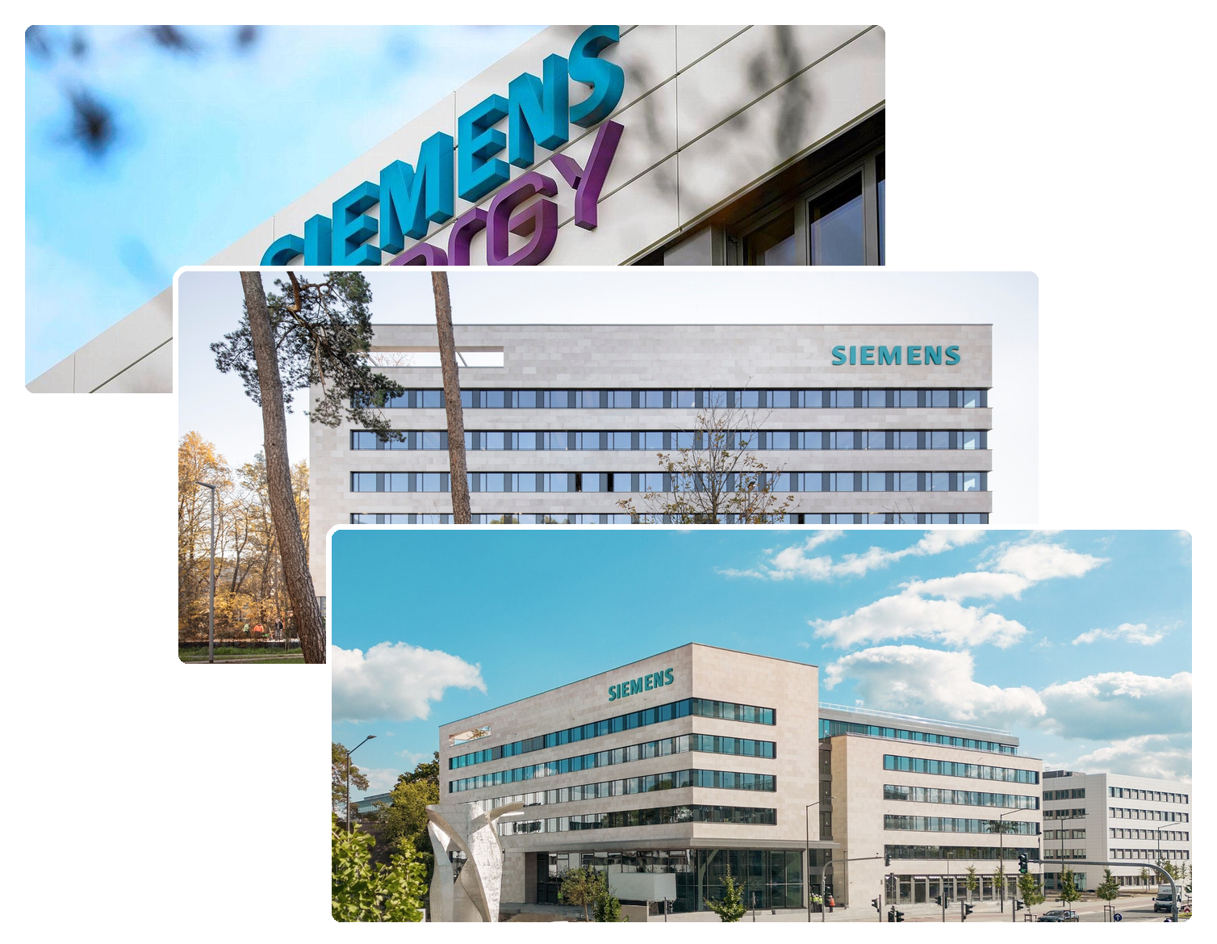
PRESENTATION CONTEXT
Agenda
1. Company context
2. Project story
3. User stories
4. Requirements
5. System architecture
6. Structure and model
7. Design decisions
AI-powered enterprise document retrieval system | Md Fahim Hossain | July 2026
02 / 11
Notes:
I will begin with the company context and my internship role.
After that, I will explain the project epic, which describes the main problem and the overall goal of the system.
Then I will discuss the user stories and the main functional and non-functional requirements.
The second half of the presentation focuses on the system architecture, the use-case and database models, and the architectural decisions used during implementation.
Finally, I will summarize the main outcomes of the project.

Slide 3
INTRODUCTION
Company Context
Siemens Energy
Industrial digitalization environment
Project Scope
Enterprise documents
SE GT DG OE
Knowledge retrieval
Department supporting digital solutions
Secure access
Academic reporting
Internship Role
Software engineering and digitalization
AI-powered enterprise document retrieval system | Md Fahim Hossain | July 2026
03 / 11
Notes:
The project was completed at Siemens Energy within the SE GT DG OE department.
The department supports digitalization activities and develops solutions that improve internal processes, data accessibility, and operational efficiency.
During my internship, I worked in a software engineering and digitalization role. My work covered the main software-development activities, including requirement analysis, system design, backend development, interface implementation, and technical documentation.
The project focused on enterprise documents and knowledge retrieval. Organizations often store important information in technical reports, manuals, process descriptions, and operational guidelines.
Although this information already exists, finding one specific detail can require significant manual effort. The project therefore aimed to provide a more structured and secure way of accessing this knowledge.
Security was also important because users should only be able to access their own documents and conversations, while administrative functionality should remain restricted to authorized roles.

Slide 4
INTRODUCTION
Project Epic
1
2
3
4
Documents grew
Users asked
System retrieved
Responses grounded
Knowledge became hard to locate
Natural questions needed answers
Relevant chunks provided context
Answers referenced document sources
From document overload to guided retrieval
The system turns enterprise documents into searchable knowledge.
AI-powered enterprise document retrieval system | Md Fahim Hossain | July 2026
04 / 11
Notes:
This slide presents the epic, or the main story behind the project.
The starting problem was the growing number of organizational documents. As the number of files increased, useful knowledge became more difficult to locate through manual browsing or basic keyword search.
The next step was to consider how users naturally search for information. Instead of opening several documents and reading them individually, users should be able to ask questions in natural language.
The system then retrieves the most relevant parts of the selected documents and uses them as context for generating a response.
Finally, the answer is presented together with references to the original document sources, so the user can verify where the information came from.
Therefore, the project epic describes the transition from document overload to guided knowledge retrieval. The main objective was to make existing enterprise knowledge easier to find, understand, and verify.

Slide 5
SPECIFICATION
User Stories
Users
Template Format
Ask across selected documents
Grounded answers with references
As a role
Administrators
Manage users and activity
I want capability
Secure and reliable platform
So that value
Document owners
Upload and monitor processing
Knowledge becomes searchable
AI-powered enterprise document retrieval system | Md Fahim Hossain | July 2026
05 / 11
Notes:
The stakeholder needs were translated into user stories using the common format:
“As a role, I want a capability, so that a particular value can be achieved.”
This structure helped transform general expectations into clear and implementable software features.
For users and knowledge workers, the main need was to ask questions across selected documents and receive responses supported by references.
For example, a user wants to select one or more processed documents and ask a natural-language question so that relevant information can be obtained without manually searching every file.
Administrators have a different responsibility. They need access to management and monitoring functions so that the system remains secure and reliable.
Document-related workflows were also important. Users need to upload documents, monitor their processing status, and know when the documents are ready for use.
Each user story included acceptance criteria, which later provided a basis for implementation, testing, and validation.

Slide 6
SPECIFICATION
Requirements
Functional
Non-functional
Secure login and roles
Responsive asynchronous processing
Upload and process documents
Scalable modular architecture
Semantic search conversations
Data isolation and reliability
References with generated responses
Maintainable documented design
AI-powered enterprise document retrieval system | Md Fahim Hossain | July 2026
06 / 11
Notes:
The requirements were divided into functional and non-functional requirements.
The functional requirements describe what the system must do.
They include secure authentication, role-based access, document upload and management, automated document processing, conversational retrieval, source references, and conversation history.
After a document is uploaded, the system processes it automatically and prepares it for semantic retrieval. Once processing is complete, the document can be selected as a knowledge source in a conversation.
The non-functional requirements describe how the system should operate.
Long-running processing must run asynchronously so that the interface remains responsive. User data must remain isolated, failed documents must not become available for retrieval, and the application structure should remain maintainable.
Some requirements were also measurable.
Successful uploads should be acknowledged within three seconds. At least ninety percent of questions should receive a response within twenty seconds under normal conditions. The application should also support at least ten concurrent authenticated users without failure or inconsistent data.
These measurable requirements later provided clear targets for verification and validation.

Slide 7
DESIGN
System Architecture
Web interface
Blade and JavaScript
Document Processing & Embedding
Text extraction, OCR and embeddings
Database & Vector storage
PostgreSQL with pgvector extension
Grounded response
Language model with context
AI-powered enterprise document retrieval system | Md Fahim Hossain | July 2026
07 / 11
Notes:
This slide presents the high-level architecture of the system.
Users interact with the application through the web interface. From there, they can authenticate, upload documents, monitor processing, manage conversations, and submit questions.
When a document is uploaded, the application first validates and stores the file. The remaining processing stages are then dispatched to background jobs.
Text is extracted directly from digital documents. For scanned PDF files, optical character recognition is used.
The extracted content is cleaned and divided into smaller semantic chunks. Each chunk is then converted into a vector representation using an embedding model.
These vectors are stored together with the document information in PostgreSQL, using vector-search capabilities.
When a user asks a question, the retrieval component searches only the selected documents and identifies the most relevant chunks.
These chunks are provided as context for response generation. The final response is returned to the user with source references and stored in the conversation history.
The main design benefit of this architecture is separation of responsibilities. The web interface, document processing, semantic retrieval, data storage, and response generation remain independent from one another.
This makes the system easier to maintain, test, and extend.

Slide 8
DESIGN
Structure and Models
Use cases
Database Design
PHP 8.4
Laravel 12
PostgreSQL
JavaScript
OCR pipeline
AI-powered enterprise document retrieval system | Md Fahim Hossain | July 2026
08 / 11
Notes:
This slide connects the behavioural and structural views of the system.
On the left, the use-case diagram shows how users and administrators interact with the application.
The main user interactions include logging in, uploading and managing documents, monitoring document processing, starting conversations, asking questions, querying multiple documents, viewing references, and reopening previous conversations.
Administrators have additional access to system-management and monitoring functions.
On the right, the database model shows how the required information is stored.
Users are connected to their documents and conversations. Documents contain metadata and processing status. The extracted content is stored as document chunks, together with the information required for retrieval and references.
Conversations are connected to one or more selected documents, while messages store the questions and generated responses.
The implementation environment includes PHP 8.4, Laravel 12, PostgreSQL, JavaScript, and an OCR-enabled document-processing pipeline.
Together, these models show how user requirements were translated into software structure and persistent data.

Slide 9
DESIGN
MVC and Hexagonal Architecture
MVC for web application
Laravel separates interface and logic
Hexagonal service boundaries
External services remain replaceable
Queues isolate long tasks
Processing continues in background
RBAC protects enterprise data
Access follows user responsibilities
AI-powered enterprise document retrieval system | Md Fahim Hossain | July 2026
09 / 11
Notes:
Several architectural principles guided the implementation.
First, the web application follows the Model–View–Controller pattern.
Controllers handle incoming requests, validation, and authorization. Models represent the persistent data, while views are responsible for presenting information to the user.
Complex business logic was not placed directly inside controllers. Tasks such as document extraction, chunking, embedding generation, semantic retrieval, and response generation were implemented through dedicated services.
The design also follows hexagonal architectural principles around external components.
The core application coordinates the workflow but does not depend directly on the internal details of document-processing tools, embedding models, or response-generation services.
These components are accessed through dedicated service boundaries. This reduces tight coupling and makes them easier to replace or extend.
Background queues were used to isolate long-running tasks, allowing document processing to continue without blocking the user interface.
Role-based access control was also applied to protect documents, conversations, and administrative functions.
Together, these decisions improved maintainability, testability, and separation of responsibilities.

Slide 10
CLOSING
Conclusion
Secure document management
Automated processing pipeline
Semantic document retrieval
Grounded response generation
Extensible enterprise architecture
The project translated enterprise knowledge needs
into a maintainable software architecture.
AI-powered enterprise document retrieval system | Md Fahim Hossain | July 2026
10 / 11
Notes:
To conclude, the project produced a clear specification and a maintainable design for an enterprise document retrieval system.
The requirements, user stories, architectural models, and database design provided a structured foundation for implementation.
The system supports secure document management, asynchronous processing, semantic retrieval, conversational question answering, and grounded responses with source references.
From a software engineering perspective, the most important outcome was the modular structure of the application.
The individual responsibilities are clearly separated, external components are accessed through service boundaries, and long-running tasks are handled in the background.
Overall, the project demonstrated how an enterprise knowledge-access problem can be translated into a practical and extensible software architecture.

Slide 11
Thank you for your attention
Questions?
Enterprise RAG system | Master's internship presentation
AI-powered enterprise document retrieval system | Md Fahim Hossain | July 2026
11 / 11
Notes:
That concludes my presentation on the software specification and design of the AI-powered enterprise document retrieval system.
Thank you very much for your attention.
I am happy to answer any questions regarding the requirements, architecture, data model, document-processing workflow, or the design decisions used in the project.

